Slide 1
IoT Enabling Technologies
Dr S M Lambor

Slide 2
IoT Enabling Technologies
y
Wireless Sensor Networks
Cloud Computing
Big Data Analytics
Embedded Systems
Security Protocols and Architectures
Communication Protocols
Web Services
Mobile Internet
Semantic Search Engines
Cloud and Big Data
Wireless Technologies
Data analysis and A small device that can be carried all around easily
Ease of connection
Enabling Technologies
·
"
Power Smart
Smart Phones
Uses the smallest battery possible and does not need to be recharged often.
Become a standard in monitoring and control devices.
⬅
G
Processing Power
Sensor Technology
Ability to process much more at reasonable prices
Y
New sensors are so small they can be worn or even ingested

Slide 3
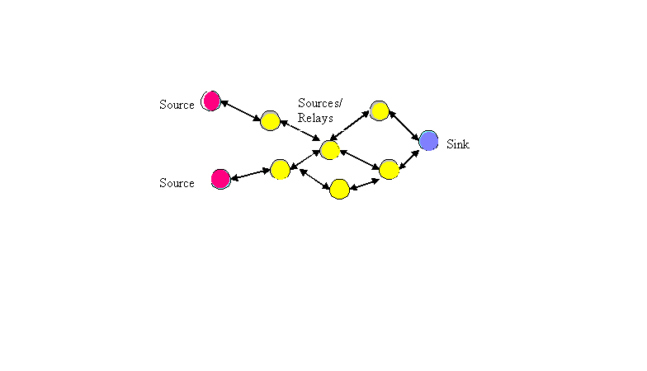
Wireless Sensor Networks
A wireless sensor network (WSN) is a wireless network consisting of spatially distributed autonomous devices using smart sensors to cooperatively monitor physical or environmental conditions, such as temperature, sound, vibration, pressure, motion or pollutants, at different locations.
WSN is a collection of nodes organized into a cooperative network.
Each node consists of
Processing capability
Multiple types of memory
RF transceiver
Power source (e.g., batteries and solar cells)
Various sensors.
Communication Protocols: IEEE 802.11, IEEE 802.15.4

Slide 4
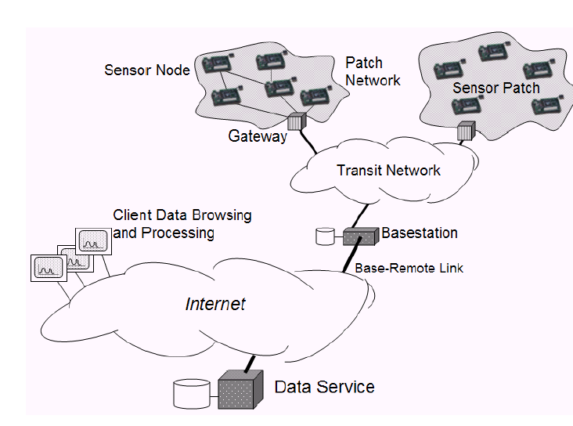

Slide 5
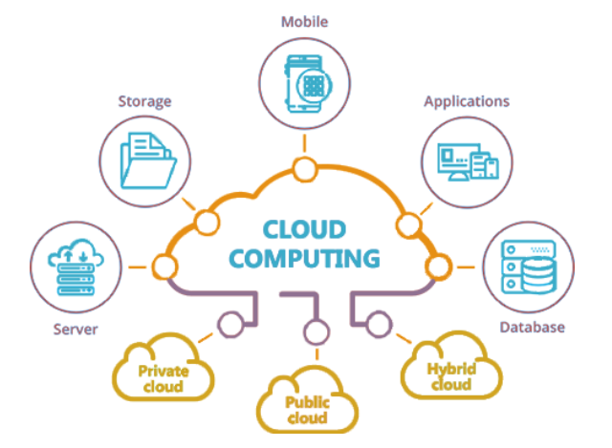
Cloud Computing
Cloud Computing is a transformative computing paradigm that involves delivering applications and services over the Internet.
Provisioning of Computing, Networking, and Storage resources on demand and providing these resources as metered services to the users , in a “Pay as you Go” model.
Convergence
Contents
Computing
Data stored in the “Cloud”
Data follows you & your devices
Data accessible anywhere
Data can be shared with others
Communication
Connectivity
5C+5Any
Any Time
Any Where
Characteristics
Broad network access
On demand self-services
Rapid scalability
Measured service
Pay-per-use
Any Service
Any Network
Any Object

Slide 6
Conceptual Diagram for Cloud based IoT
Cloud computing services are offered to users in different forms.
IaaS- (Infrastructure-as-a-service)
Provides users the ability to provision computing and storage resources.
Resources in the form of Virtual machine instances and Virtual storage.
Ex : Web Hosting, Virtual Machine etc.
PaaS- (Platform-as-a-service)
Provides users the ability to Develop and deploy applications in the cloud using development tools, APIs, software libraries and services provided by the cloud.
Ex : App Cloud, Google app engine
SaaS- (Software-as-a-service)
Provides users a complete software application or the user interface to the application itself.
Ex : Google Docs, Gmail, office etc.
Cloud
-
based Services of Things
Smart
Services
Cloud Computing
Service
Software
Platform
Infrastructure
Provisioning
(
SaaS
)
(
PaaS
)
(
IaaS
)
&
Management
(Security, OAM,
Virtual Resources
Self Management)
(Control, transport, computing & storage, access resources)
Ubiquitous Access/
Seamless Connectivity
Smart
Environment
Humans
with Attached Devices
Objects
(Remote Monitoring and
Information Devices, Contents)

Slide 7
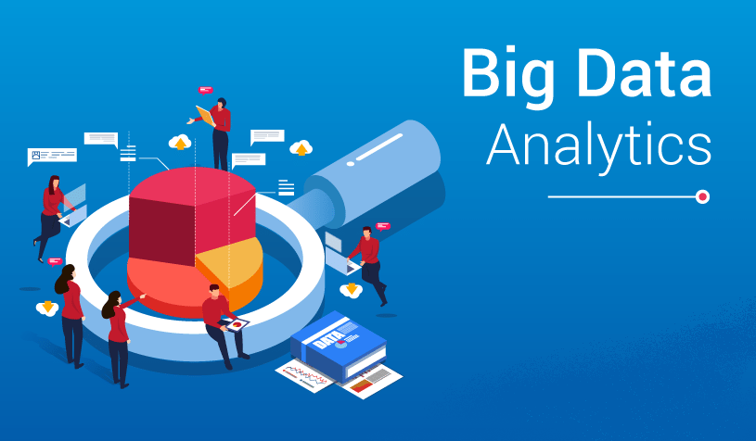
Big Data Analytics
Collection
Ingestion
Discovery & Cleansing
Integration
Analysis
Delivery
Big Data Value Chain
Collection – Structured, unstructured and semi-structured data
from multiple sources
Ingestion – Loading vast amounts of data onto a single data store
Discovery & Cleansing – Understanding format and content;
clean up and formatting
Integration – linking, entity extraction, entity resolution,
indexing and data fusion
Analysis – Intelligence, statistics, predictive and text analytics,
machine learning
Delivery – querying, visualization, real time delivery on
enterprise-class availability

Slide 8
Big Data Considerations
Variety of Use Cases
Mobility
Security & Privacy
Lifecycle Management & Data Quality
System Management & Other Issues
Data Characteristics
  Distributed / Centralized
  The 4 Vs : Volume, Velocity, Variety, Veracity
Data Collection
Data Visualization
Data Quality
Data Analytics & Action
Sensors
Applications
Software agents
Individuals
Organizations
Hardware resources
Anytime
Anything
Any Device
Any Context
Any Place
Anywhere
Any one
Data Sources

Slide 9
Communication Protocols
Backbone of IoT Systems
Enables network connectivity
Allows devices to exchange information / data over the network
Various application layer protocols define
  Data exchange formats
  Data encoding
  Addressing mechanisms
  Data rate / flow control
  Security features

Slide 10
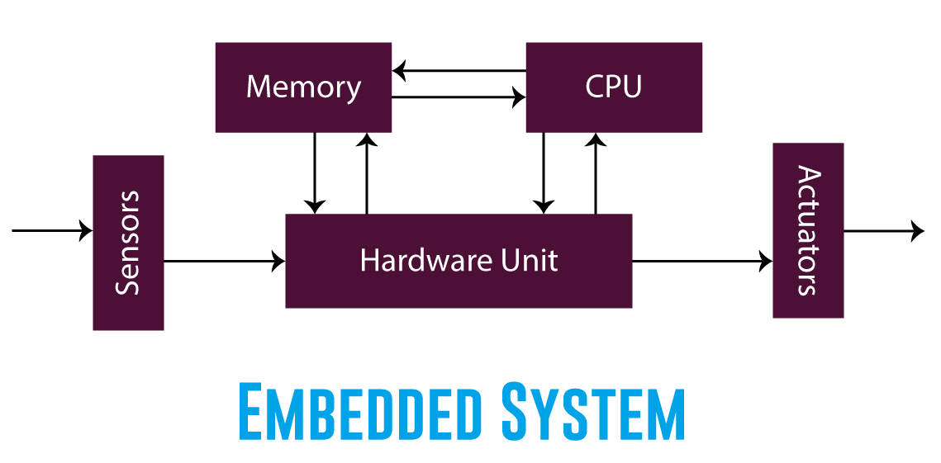
Embedded Systems
A system that has computer hardware and software embedded to perform specific tasks
Key components of an embedded system are
  Microcontroller
  Memory (RAM / ROM / Cache)
  Networking units (Ethernet / WiFi adapters)
  Input Output (I/O) units (Keyboard, display etc)
  Storage (Flash / cloud connectivity)
  Specialized processors like digital signal processors(DSP),
  graphic processors, other specialized processors.
  Operating systems (RTOS)
Examples
  Digital camera
  DVD player, music player
  Industrial robots
  Wireless Routers etc.

Slide 11
Thank You

